Slide 1
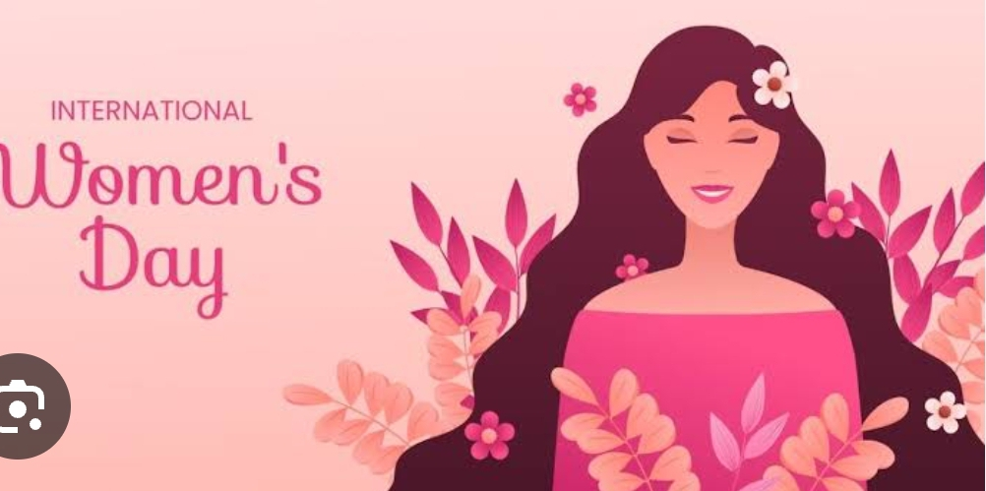
Women's Empowerment
Empowering women is essential for achieving gender equality and societal progress. It involves recognizing and enhancing women's abilities, allowing them to make choices and exert influence in various spheres of life.

Slide 2
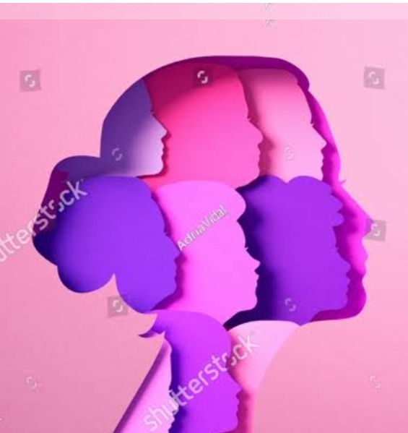
Gender Equality
1
Equal Opportunities
2
Ending Discrimination
Ensuring fairness and justice in all areas of life, including education and employment.
Challenging prejudiced attitudes and practices to create a level playing field for all genders.
3
Empowering Policies
Implementing policies that support gender equality and protect women's rights.

Slide 3
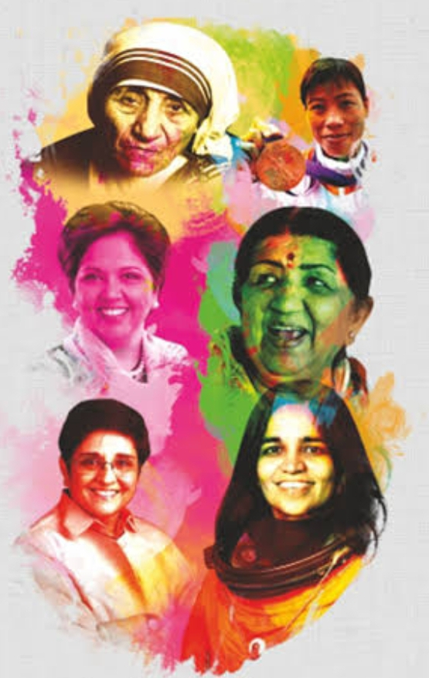
Women's Rights
1
Historical Struggles
Women's long fight for basic rights, suffrage, and legal recognition.
2
Legal Reforms
Progressive changes in laws to protect women's rights and promote gender equality.
3
Ongoing Advocacy
Current movements and organizations advocating for women's rights and equality.

Slide 4
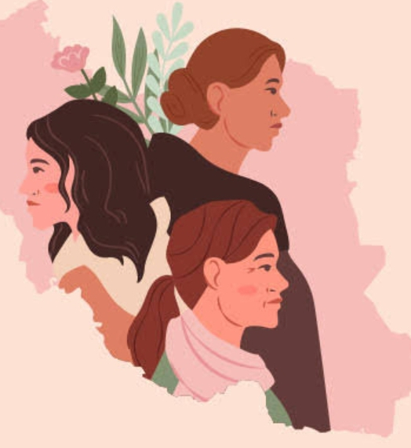
Women in Leadership
Breaking Barriers
Inspiring Change
Creating Impact
Role models who inspire and pave the way for future female leaders.
Contributions of women leaders in various fields, from politics to business.
Women overcoming stereotypes to take on leadership roles.

Slide 5

Women in the Workforce
Workplace Challenges
Skills Development
Support Networks
Addressing issues such as unequal pay, career advancement, and work-life balance.
Investing in training and mentorship for women to thrive in their careers.
Creating communities and resources to foster professional growth and success.

Slide 6
Women's Health
1
Reproductive Rights
2
Mental Well-being
3
Healthy Lifestyles
Access to healthcare services and decision-making autonomy for women's reproductive health.
Addressing mental health challenges and promoting emotional wellness for women.
Promoting nutrition, fitness, and overall well-being for women of all ages.

Slide 7
Women's Education
130M+
4.2M
Global Literacy
Scholarship Gaps
Over 130 million girls worldwide are out of school, impacting their future prospects.
4.2 million fewer girls than boys receive primary and secondary education.

Slide 8



Women's Representation in Media
Inclusive Narratives
Fair Visibility
Positive Influence
Representation of women of all backgrounds and experiences in media storytelling.
Equal exposure and recognition of women's accomplishments in the media.
Inspiring and empowering portrayals of women's strength and resilience in media.

Slide 9


